Slide 1
Experiment
After 20+ years of insomnia,
I finally fixed mine.
Not with one change — with a plan.
This experiment:
A personal project
Does it work for others?
A book: my experience.
Notes:
Before we get started.
Where are you joining from and whats the local time?
How many hours sleep (use a range if you like)
Taking prescription meds.
Key pacing advice (most important)
Don’t aim for speed—aim for space.
The moments that need breathing room:
Slide 5 (“Sleep isn’t a switch”)
Slide 8 (fitness realization)
Slide 13 (why nothing worked)
Slide 19/20 (aligned vs misaligned)
Slide 22 (what changed everything)
If you rush those, the whole talk feels flatter.

Slide 2
What we’ll cover today
A new way to understand sleep
What needs to happen in your body for good sleep
The plan I used to get there.
Notes:
“If you’re here, there’s a good chance you feel tired… but when it’s time to sleep, your mind won’t switch off.”

Slide 3
This was me
4 to 5 hours of broken,
poor-quality sleep,
since my 20’s.
(Better & worse patches sometimes)
Constant search:
I just need to find…
‘one thing’ to make me sleep better?
Notes:
Some people - way worse.
Most of the population have it way better.
Better, worse, same in comments.

Slide 4
I tried everything
Sleeping pills
Alcohol
Modafinil (2000’s)
Supplements - too many to list
THC, CBD, CBN
Diet – No sugar, Keto
Exercise – to extreme exhaustion
Hypnosis
Theta wave music (certain frequencies)
Meditation
Night-time routines
Morning light

Slide 5
I tried everything
Hack after hack didn’t work.
Each one: “it just doesn’t work for me”
Desperate for something…
At same time, it bugged me:
Why did I need help at all?
Notes:
I spent years trying to fix my sleep with one thing.
I’d try each latest-thing for a while… it wouldn’t work… I’d decide “it must not work not for me”… and move on to the next.
Nothing changed. Until I finally realised – I keep searching for better painkillers… maybe I should deal with the injury.
It took a lot of research before I saw sleep more like fitness.
I can’t just stop eating chocolate and be fit.
It takes the right combination of a few things, done consistently, over time.
I realised I had to improve my ‘sleep fitness’ – to get the conditions right, so sleep could happen naturally.
Only then would I finally get the sleep I’d been missing.

Slide 6
Breakthrough came
I finally learned…
We don’t control sleep directly.
I was treating like a
magic switch… if I could only find it.
But not how it works.

Slide 7
Controlled by hormones
Sleep depends entirely on hormones.
Right ones –
rise and fall,
right time,
over a 24hr cycle.

Slide 8
It’s like…
Complex process…
But, it’s a lot like fitness.
If I drank, smoked, bad food, no exercise..
“What’s one thing I can take to be fit…
nope, tried that, doesn’t work for me.”
That’s how I was treating sleep.
Getting fit =
new habits, training, commitment .
Not instant transformation.

Slide 9
Control the hormones
Sleep is the same.
It’s not something you can switch on—
it’s something you train.
Build new habits,
create the right conditions…
And hormones begin to align.
Notes:
I spent years trying to fix my sleep with one thing.
I’d try each latest-thing for a while… it wouldn’t work… I’d decide “it must not work not for me”… and move on to the next.
Nothing changed. Until I finally realised – I keep searching for better painkillers… maybe I should deal with the injury.
It took a lot of research before I saw sleep more like fitness.
I can’t just stop eating chocolate and be fit.
It takes the right combination of a few things, done consistently, over time.
I realised I had to improve my ‘sleep fitness’ – to get the conditions right, so sleep could happen naturally.
Only then would I finally get the sleep I’d been missing.

Slide 10
3 things to train
Like fitness,
it comes down to a few basics:
1. Training your body clock
(consistent timing and rhythm)
2. Training your nervous system
(switch off at night)
3. Managing your inputs
(food, drink, supplements – support and not undo)

Slide 11
Why train these things
These are the levers.
Train them → hormones align.
To understand why it works…
Understand: what influence
you have on good sleep.
The hormones are the explanation.

Slide 12
Four key hormones
There are many hormones involved.
But it turns out,
you have most leverage over just four:
2 sleep:
Adenosine (sleep pressure)
Melatonin (sleep timing)
2 wake:
Dopamine (stimulation)
Cortisol (alertness)
Notes:
“These are the signals your body is using all day…”
“The goal isn’t to control them directly —
it’s to create the conditions that influence them.”
“Everything we just talked about — the conditions —
are simply ways of influencing these signals.”

Slide 13
Not everything needs fixing
There are many many others.
Serotonin, GABA, Orexin, Histamine…
Thyroid, Estrogen, Adrenaline, Leptin, Ghrelin, Insulin, Prolactin, Progesterone, Glutamate…
But you don’t need to target each one.
Focus on the 4 key hormones,
and the rest start to follow.
Notes:
“Your body already wants to sleep.”
“Trying to target hormones individually doesn’t help…”
“Get conditions right > system works properly.”
“Yes they are a part of sleep > but we focus on the few signals that have the most influence”

Slide 14
Sleep Incorporated
Executives set the direction
Sleep execs - say ‘sleep’.
Wake execs - silent.
You Sleep.
Melatonin - says ‘sleep’
Cortisol - shouts ‘wake up’
Managers & Workers – wtf?
Note: Hacks and pills. Menopause & rare diseases.
Executives
Sleep Melatonin Adenosine
Wake
Dopamine
Cortisol
Managers
Serotonin,
Prolactin, Thyroid…
& many others
Workers
Histamine, Orexin,
GABA… & many others
Note: This is not a perfect biological model. This is a model of control mechanisms. Executives are key hormones you can leverage with daily choices.
(also, technically adenosine is a neuromodulator, not a hormone. Buts it’s close enough I’m calling it one, for simplicity).
Notes:
Type any medication in to AI
Stress - Neuroscientist, this isn’t 100% correct.
Top 4 perfect - Diseases, Menopause – knock out lower levels.
This is not a complete biological model — it's a practical one.
The Executives are = daily choices have leverage.
Executives (4 key hormones) Conditions right → Executives aligned → messages are clear → “be asleep” or “be awake” When messages are mixed → Melatonin shouts “be asleep” but Cortisol shouts “be awake” → everything below gets messy. Hacks, pills & rouge managers Singular hacks can rarely align all executives Rouge manager – specific problems with one hormone – e.g. certain diseases or menopause. Pills target downstream workers (treat the symptoms) – not the core messages.
.

Slide 15
What this looks like in your body
When conditions are right,
the ‘Executives’ align.
And everyone in Sleep Inc
turns up for work at
the right times,
in the right amounts,
across 24hrs.
Influence the Executives → influence sleep.
Here’s what each Executives looks like…

Slide 16
Adenosine (sleep pressure)
Bedtime
Creates pressure for sleep.
Day
Day
Night
Night
Clears overnight in Deep Sleep
Builds through the day

Slide 17
Melatonin (sleep timing)
Bedtime
Signals its time for sleep
Day
Night
Beginning to peak at bedtime
Rises sharply as bedtime approaches

Slide 18
Dopamine (wake – stimulation)
Bedtime
Keeps focus - create, learn, be motivated.
Day
Night
Engaged during the day.
Interested = motivated.
Low at night

Slide 19
Cortisol (wake - alertness)
Bedtime
Keeps you awake and dealing with stress.
Day
Night
Rises sharply to wake you up
Baseline falls through the day
Low at night
Notes:
stress response – work, kids, modern life, exercise

Slide 20
When it all lines up
Bedtime
Sleep hormones are high.
Wake hormones are low.
Message clear - Time for sleep
Day
Night
Sleep hormones
high.
Wake hormones
low.
Notes:
A lot to take in.
This should be happening in your body everyday.
As long as right signals rise and fall at the right time…
Adenosine & Melatonin high, Cortisol and Dopamine low at bedtime…
Sleep happen naturally.

Slide 21
When it doesn’t
Bedtime
When conditions are off:
You hit bedtime…
Adenosine is high — you’re exhausted.
Wake hormones shout:
“wake up”.
Melatonin says:
“missed your window” or
“not yet”.
Hormones are fighting each other.
Exhausted but can’t sleep – tired but wired
Day
Night
Notes:
Terrible sleep last night – adenosine doesn’t clear – starts the day high – finished off the chart: you are exhausted.
But Melatonin timing is off – either peaked early, missed window OR not ready to sleep yet.
Elevated wake hormones - Cortisol and Dopamine – shouting “stay awake”.

Slide 22
Fixing it - why nothing had
worked for me
Many things I had tried weren’t wrong —
science shows they work.
It’s not: ‘they don’t work for me’.
The problem is…
they don’t work on their own.
They needed to be stacked together.

Slide 23
Fixing it - my approach
I decided:
No magic tricks.
No more chasing quick fixes.
Instead:
Take the best of proven techniques, and
stack them together
in a way that works
And… keep it as simple as possible
Notes:
Afterall - I was sleep deprived and overwhelmed already.

Slide 24
My Sleep Fitness Program
I called it My Sleep Fitness Program.
Goal:
Train the right habits,
to align my hormones,
and bring back my sleep.
Notes:
Going a bit into the science –
It’s a little bit to get your head around.
But it really explains WHY this plan worked for me, when everything else failed.
Bare with me.

Slide 25
Three parts - recap
Train my body clock
→ so my body knows when to sleep
Train my nervous system
→ so it can switch off at night
Managing my inputs
→ so nothing interferes with training

Slide 26
How it applies to this experiment
Not everything at once.
Broken into 5 phases, over 5 weeks.
Make small changes at a time.
Build, step by step.

Slide 27
The progam
Week 1: Foundation
→ sleep tracking, bedroom environment, supplements
Week 2: Remove disruptors
→ caffeine, alcohol, can’t sleep routine
Week 3: Reset rhythm
→ morning routine, evening routine, napping
Week 4: Learn to switch off
→ wind-down, reduce stress
Week 5: Fine-tune
→ food timing, exercise, hydration, social media

Slide 28
Tracking progress
I have an app for this experiment.
Track each level
Track the habits you’re training
Track your sleep
Measure your progress…
and (hopefully) your success!

Slide 29
Community / Engagement
You’re not doing this alone.
Use the facebook group.
Ask questions
Share progress
Learn from others
Stay consistent
Privacy Promise:
I won’t share any data about you.
If I publish results it won’t contain
anything that can be used to identify you.

Slide 30
Next steps
If this resonates,
be part of the experiment!
It’s a personal experiment (not funded)
Free to join. Only cost:
- Buy a sleep/fitness tracker.
- Buy supplements (not from me)
Join here:
http://somelink.com
Notes:
Any follow up, I will post in the Group.

Slide 31
Thankyou
Questions?
Thoughts?
Feedback?
Notes:
Any follow up, I will post in the Group.

Slide 32
Adenosine - sleep pressure
Sleep hormones are high.
Wake hormones are low.
Message clear - Time for sleep
Bedtime
Day
Night
Clears overnight in Deep Sleep
Builds through the day
Notes:
A lot to take in.
This should be happening in your body everyday.
As long as right signals rise and fall at the right time…
Adenosine & Melatonin high, Cortisol and Dopamine low at bedtime…
Sleep happen naturally.

Slide 33
When it all lines up
Sleep hormones are high.
Wake hormones are low.
Message clear - Time for sleep
Bedtime
Day
Night
Sleep
hormones
high.
Wake
hormones
low.
Notes:
A lot to take in.
This should be happening in your body everyday.
As long as right signals rise and fall at the right time…
Adenosine & Melatonin high, Cortisol and Dopamine low at bedtime…
Sleep happen naturally.

Slide 34
Adenosine - sleep pressure
Bedtime
Creates pressure for sleep.
Day
Day
Night
Night
Clears overnight in Deep Sleep
Builds through the day

Slide 35
Melatonin - sleep timing
Sleep hormones are high.
Wake hormones are low.
Message clear - Time for sleep
Bedtime
Day
Night
Rises sharply as bedtime approaches
Starts dropping mid-sleep
Notes:
A lot to take in.
This should be happening in your body everyday.
As long as right signals rise and fall at the right time…
Adenosine & Melatonin high, Cortisol and Dopamine low at bedtime…
Sleep happen naturally.

Slide 36
Melatonin - sleep timing
Signals its time for sleep
Bedtime
Day
Night
Starts dropping mid-sleep
Rises sharply as bedtime approaches

Slide 37
Dopamine: wake – stimulation
Sleep hormones are high.
Wake hormones are low.
Message clear - Time for sleep
Bedtime
Day
Night
Engaged during the day.
Interested = motivated.
Low at night
Notes:
A lot to take in.
This should be happening in your body everyday.
As long as right signals rise and fall at the right time…
Adenosine & Melatonin high, Cortisol and Dopamine low at bedtime…
Sleep happen naturally.

Slide 38
Dopamine (wake – stimulation)
Bedtime
Keeps focus - create, learn, be motivated.
Day
Night
Engaged during the day.
Interested = motivated.
Low at night

Slide 39
Cortisol: wake - alertness
Sleep hormones are high.
Wake hormones are low.
Message clear - Time for sleep
Bedtime
Day
Night
Rises sharply to wake you up
Baseline falls through the day
Low at night
Notes:
A lot to take in.
This should be happening in your body everyday.
As long as right signals rise and fall at the right time…
Adenosine & Melatonin high, Cortisol and Dopamine low at bedtime…
Sleep happen naturally.

Slide 40
Cortisol (wake - alertness)
Bedtime
Keeps you awake and dealing with stress.
Day
Night
Rises sharply to wake you up
Baseline falls through the day
Low at night
Notes:
stress response – work, kids, modern life, exercise

Slide 41
Conditions aren’t right → signals messy → sleep broken
Body clock
→ different bedtimes
→ inconsistent get-up times
→ not enough daylight
Nervous system
→ mind won’t switch off
→ stress, anxiety, overthinking
→ always “on”
Inputs
→ too much caffeine
→ wrong foods or exercise
→ scrolling at night
Day
Night
Notes:
Most people, including me, try to fix sleep one thing at a time.
Nothing really changes… so you drop it and move on.
But sleep doesn’t work like that.
It only responds when you do the right things, consistently.

Slide 42
Sleep #1 – Adenosine – what goes wrong?
Adenosine doesn’t clear properly if Deep Sleep is short.*
Not really a problem for sleep – you are either normal-tired, or completely exhausted.
Day
Day
Night
Night
*Reasons include; elevated cortisol, caffeine, alcohol, awakenings due to - noise, temperature or light.

Slide 43
Sleep #2 – Melatonin – what goes wrong?
Peaks too early
Peaks too late
Peaks too early:
Sleep signal declined by bedtime
Peaks too late:
Don’t feel sleepy until 2am.
Day
Night
Typical reasons; irregular sleep schedule, too much (or not enough) bright light at wrong times of day. Jet lag.

Slide 44
Wake #1 – Dopamine – what goes wrong?
If Dopamine is elevated at night. You are awake and alert. Your mind might be racing or looping a particular topic.
Day
Night
Bad habits activate dopamine right before bedtime
Can’t sleep – check social media, do some gaming, interesting reading.
Racing-mind is often attributed to anxiety/worry. For some people its fuelled by dopamine. You aren’t worried, instead your mind is solving puzzles or inventing new and better ways to do things.

Slide 45
Wake #1 – Cortisol - what goes wrong?
For many possible reasons* you hit bedtime with elevated cortisol.
Result: Can’t get to sleep, racing mind, or short/shallow sleep.
Day
Night
Bad habits activate cortisol at bedtime
Nervous system cannot return you to baseline
Elevated night cortisol – awake
*Reasons include: dysregulated nervous system, bad relationship with bed, stress, anxiety, PTSD, trauma, caffeine, alcohol, poor sleep patterns, meals too late, food sensitivities, sugar, dehydration.
Stressed about not sleeping (or worse - check phone)

Slide 46
Dopamine
Learning, Seeking, anticipation, hormone
Day time friend (used productively) – excited, interested, alert.
Up and down depending on what your doing, reading, working on
Working on something interesting vs something boring.
Sleep
Adenosine high – feel tired
Melotonin high – ‘its time to sleep’
Cortisol & Dopamine – “we’re not stopping you”
Dopamine – what goes wrong
Friend of the day, enemy of the night.
Taking dopamine hits when you should be reducing activity
  Social media
  Gaming
  Learning new skills
  Interesting/suspenseful book or TV shows
Addictive and habit reinforcing.
Busy modern day – all 5 hormone
The day of a busy adult with a modern lifestyle, who sleeps well.
Coritsol, adrenaline and dopamine yoyo
Stress and activity peaks and troughs.
So long as Cortisol, Dopamine and Adrenaline are low at night.
And Melatonin and Adenosine peak at the right times…
Sleep happens as it should.
(Excluding other rouge hormones and physiologic issues)
Adenosine
Doesn’t fully clear
Struggle to get out of bed
Don’t wake up feeling refreshed
Not enough Deep Sleep – didn’t clear
Caffeine, alcohol, other medication
Dysregulated nervous system
Melatonin – what goes wrong
Peaks too late, clears too late
Can’t sleep until after midnight
Eg. Jetlag symptoms:
  Adenosine high – your tired,
  Cortisol low – your relaxed,
  Melatonin won’t give the sleep signal.

Slide 47
5 key hormones that determine how well you sleep

Slide 48
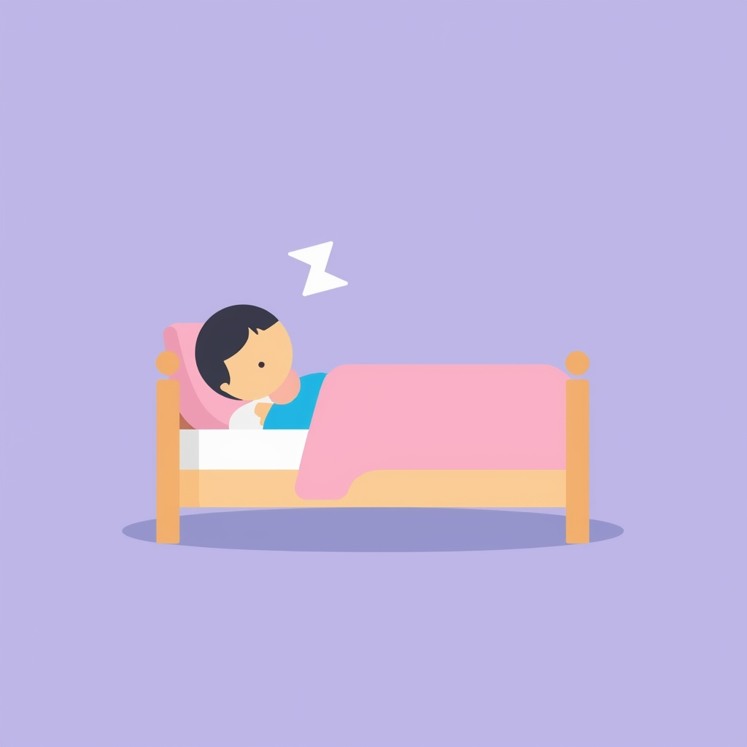

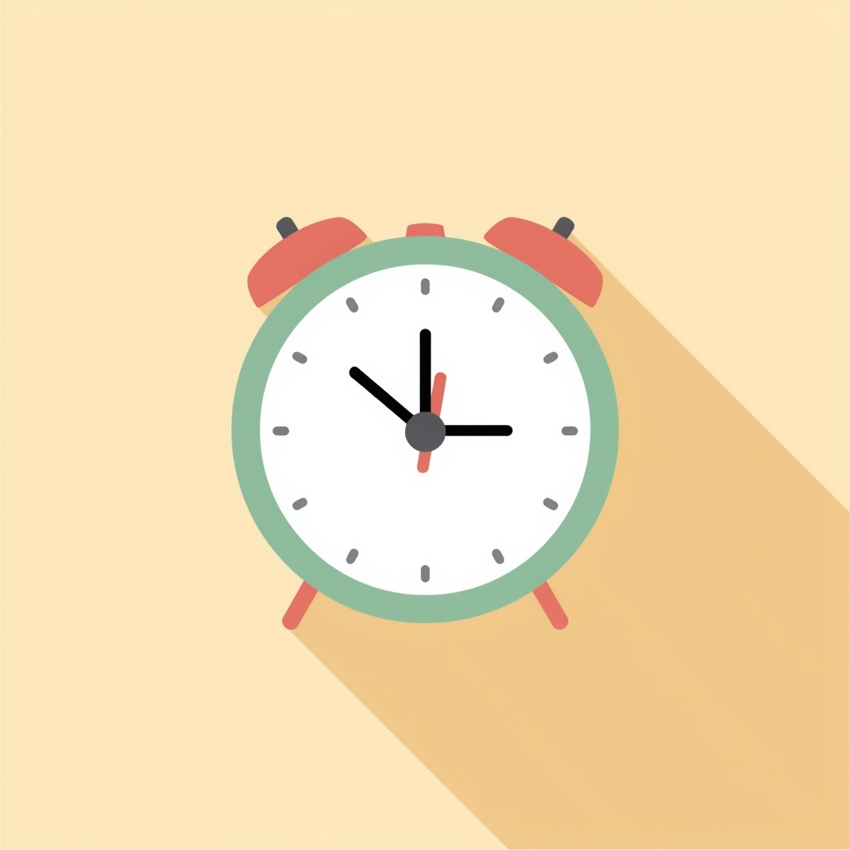
Back to basics:
Good night’s sleep needs 3 things
Your mind and body must…
Feel tired
Not be doing anything to keep you awake
Think its time to sleep

Slide 49
How sleep works
Key Players
Your body
Wants good sleep.
Its part of a 24hr process
Hormones
This process controlled by your hormones.
(chemicals that send signals around body).
2 x Sleep hormones
Good sleep
Key Players need to consistently rise and fall - right amounts, right time.
Problem
Journey here different – stress, trauma, psychological. But…
Common problem: Key Players out of sync
Solution
Simple to understand, harder to do:
Restore harmony to the key players.
2 x Wake hormones
2nd Level
3rd Level
Multiple hormones
Neurotransmitters

Slide 50
A good sleeper - all 4 hormones in harmony
High:
Adenosine – feel tired.
Melatonin – sleep time.
Low:
Dopamine – interested.
Cortisol – awake / alert.
Day
Night
Day
Night

Slide 51
Get key players realigned
Complexity
Super complex – reason no-one has found a magic on /off switch
Hard to come to terms with… exhausted, frustrated, overwhelmed, anxious…
stop search for the one thing that will finally switch on sleep.
Fitness
No: one-thing and your fit!
Takes: consistent effort over time.
Do: exercise, nutrition, good rest, supplements.
Don’t: drugs, alcohol, smoking
20+ years
I searched for 20+ years, until…
Research led me to understand sleep is more like getting fit.
Sleep
Do’s: ??
Don’ts: ??
Requires: ??
Sleep fit experiment
Plan – set daily habits that work together to build on each other and restore sleep.
Good news
Broken it down into steps
Build it as fast or slow as it works for you.
Not as much hard work, and doesn’t take as long as getting fit.
Taught from young age
Not taught

Slide 52
Get key players realigned
Science
Brings together a lot of scienfically proven
Step 1: mindset shift – done!
Step 2: sign up for the experiment.
(experiment rules)
Novel
Just like a fitness program. Doen’t need new exercises no-one has ever done before.
Do need: What is combine, how to layer them, how much and how often.
New?
Not much new.
Tried and tested.
In fact I hope you’ve heard of these,
Even tried some.
Covers
[Add 4 phases, over 5 weeks]. Check in each week.
Sleep fit experiment
Plan – set daily habits that work together to build on each other and restore sleep.
Good news
Broken it down into steps
Build it as fast or slow as it works for you.
Not as much hard work, and doesn’t take as long as getting fit.

Slide 53
Sleep isn’t something you switch on —
it’s something you train.
Notes:
I thought there was a magic sleep switch,
Everyone was different.
I just had to find the one that worked for me.
I was wrong.

